Slide 1
Business Strategy

Slide 2
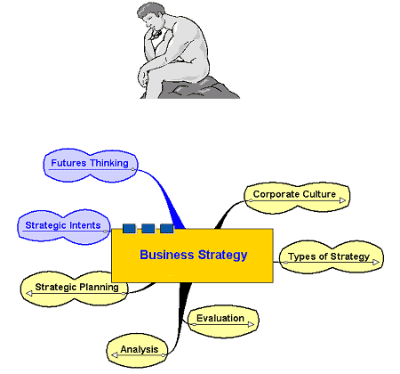
Business Strategy

Slide 3
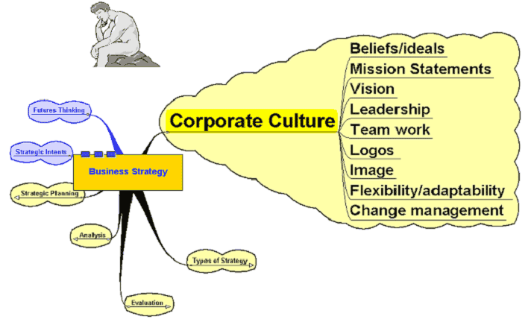
Corporate Culture

Slide 4
Corporate Culture
The beliefs and values shared by people who work in an organisation
  How people behave with each other
  How people behave with customers/clients
  How people view their relationship with stakeholders
  People’s responses to energy use, community involvement, absence, work ethic, etc.
  How the organisation behaves to its employees – training, professional development, etc.

Slide 5
Corporate Culture
May be driven by:
Vision – where the organisation wants to go in the future
Mission Statement – summary
of the beliefs of the organisation and where it is now

Slide 6
Corporate Culture
May be reflected in:
  Attitude and behaviour of the leadership
  Attitude to the role of individuals in the workplace – open plan offices, team based working, etc.
  Logo of the organisation
  The image it presents to the outside world
  Its attitude to change

Slide 7
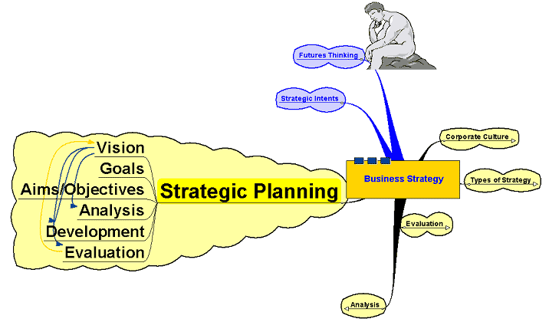
Strategic Planning

Slide 8

Strategic Planning
First Stage of Strategic Planning may involve:
Futures Thinking
  Thinking about what the business might need to do 10–20 years ahead
Strategic Intents
  Thinking about key strategic themes
  that will inform
  decision making
“The thicker the planning document, the more useless
it will be”
  (Brent Davies: 1999)
Taking time to think and reflect may be more important than many businesses allow time for!
Copyright: Intuitives, http://www.sxc.hu

Slide 9
Strategic Planning
The Vision
  Communicating to all staff where the organisation is going and where
  it intends to be in the future
  Allows the firm to set goals
Aims and Objectives:
  Aims – long term target
  Objectives – the way in which you are going to achieve the aim

Slide 10
Strategic Planning
Example:
Aim may be for a chocolate manufacturer to break into
a new overseas market
Objectives:
  Develop relationships with overseas suppliers
  Identify network of retail outlets
  Conduct market research to identify consumer needs
  Find location for overseas sales team HQ

Slide 11
Strategic Planning
Once the direction is identified:
Analyse position
Develop and introduce strategy
Evaluate:
  Evaluation is constant and the results of the evaluation feed back
  into the vision

Slide 12
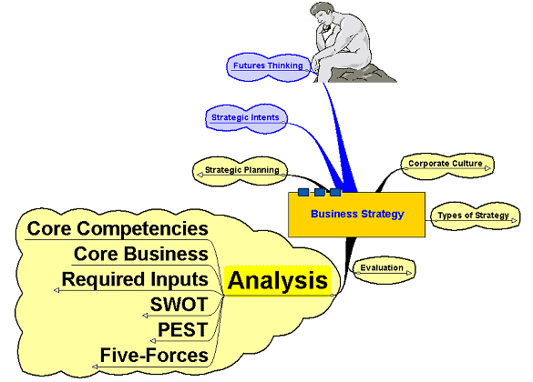
Analysis

Slide 13
SWOT
Strengths – identifying existing organisational strengths
Weaknesses – identifying existing organisational weaknesses
Opportunities – what market opportunities might there be
for the organisation to exploit?
Threats – where might the threats
to the future success come from?

Slide 14
PEST
Political: local, national and international political developments – how will they affect the organisation and in what way/s?
Economic: what are the main economic issues – both nationally and internationally – that might affect the organisation?
Social: what are the developing social trends that may impact on how the organisation operates and what will they mean for future planning?
Technological: changing technology can impact on competitive advantage very quickly!

Slide 15
PEST
Examples:
Growth of China and India as manufacturing centres
Concern over treatment of workers and the environment in less developed countries who may be suppliers
The future direction of the interest rate, consumer spending, etc.
The changing age structure of the population
The popularity of ‘fads’ like the Atkins Diet
The move towards greater political regulation of business
The effect of more bureaucracy in the labour market

Slide 16
Five-Forces
Developed by Michael Porter: forces that shape and influence the industry or market the organisation operates in.
  Strength of Barriers to Entry - how easy is it
  for new rivals to enter the industry?
  Extent of rivalry between firms – how competitive
  is the existing market?
  Supplier power – the greater the power, the less control the organisation has on the supply of its inputs.
  Buyer power – how much power do customers
  in the industry have?
  Threat from substitutes – what alternative products
  and services are there and what is the extent
  of the threat they pose?

Slide 17
Required Inputs
Changing strategy will impact on the resources needed to carry out the strategy:
Specifically the impact on:
  Land – opportunities for acquiring land for development – green belt, brownfield sites, planning regulations, etc.
  Labour – ease of obtaining the skilled and unskilled labour required
  Capital – the type of capital and the cost of the capital needed to fulfil the strategy

Slide 18
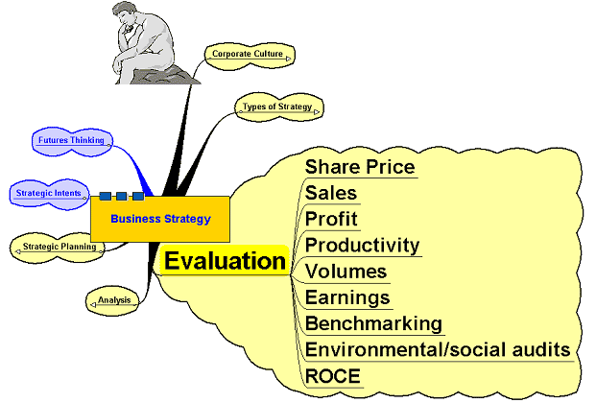
Evaluation

Slide 19
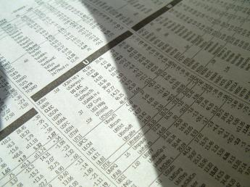
Evaluation
Data from sales, profit, etc. used to evaluate the progress and success of the strategy and to inform of changes to the strategy in the light of that data
Information from a wide variety of sources
can help to measure and inform the impact and direction of the strategy.
Copyright: Mad7986, http://www.sxc.hu

Slide 20
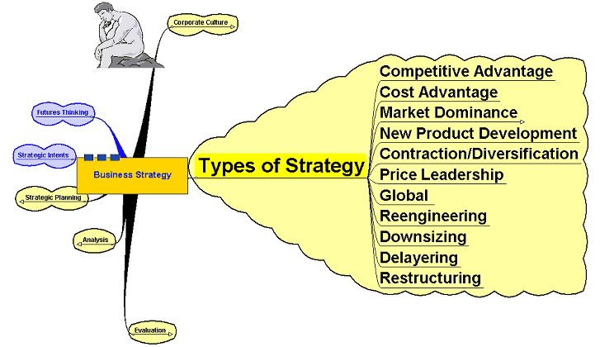
Types of Strategy

Slide 21
Types of Strategy
Competitive Advantage – something which gives the organisation some advantage over its rivals
Cost advantage – A strategy to seek out and secure a cost advantage
of some kind - lower average costs, lower labour costs, etc.

Slide 22
Types of Strategy
Market Dominance:
Achieved through:
  Internal growth
  Acquisitions – mergers and takeovers
New product development: to keep ahead of rivals and set the pace
Contraction/Expansion – focus on what you are good at (core competencies) or seek to expand into a range of markets?

Slide 23
Types of Strategy
Price Leadership – through dominating the industry – others follow your price lead
Global – seeking to expand
global operations
Reengineering – thinking outside the box – looking at news ways of doing things to leverage the organisation’s performance

Slide 24
Types of Strategy
  Internal business level strategies –
Downsizing – selling off unwanted parts of the business – similar
to contraction
Delayering – flattening the management structure, removing bureaucracy, speed up decision making
Restructuring – complete re-think
of the way the business is organised

